Slide 1

Face detection using Siamese network
ENEl 645 – Data MINING & machine learning – Team 8

Slide 2
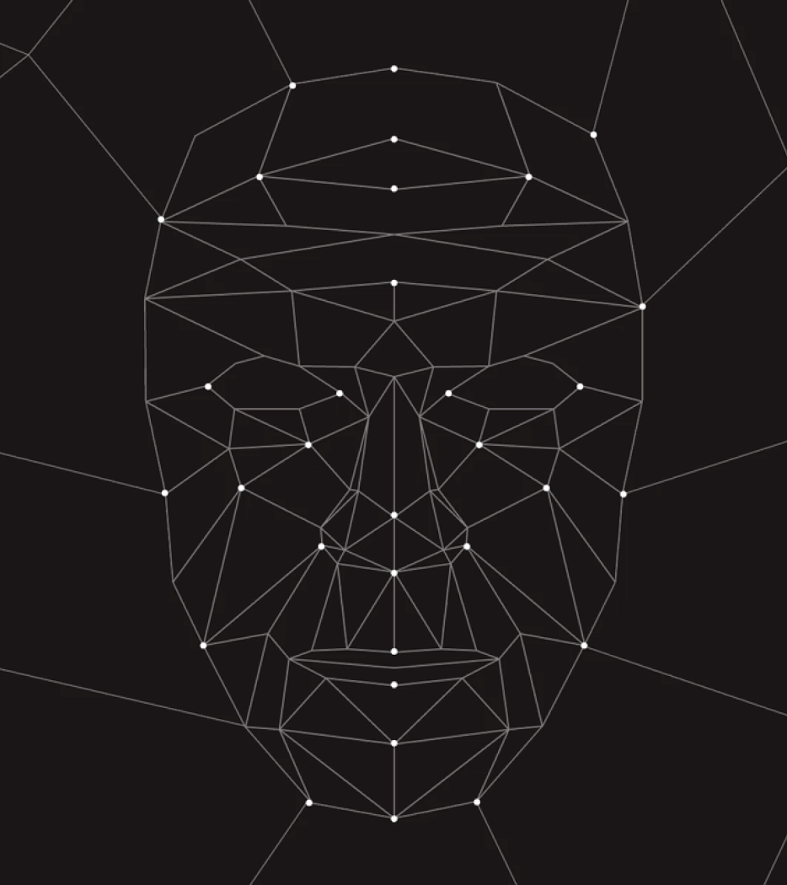
PRESENTATION FLOW
INTRODUCTION
DATA CREATION
DATA PRE-PROCESSING
SIAMESE NETWORK
MODEL TRAINING
RESULTS
CHALLENGES
CLOSING

Slide 3
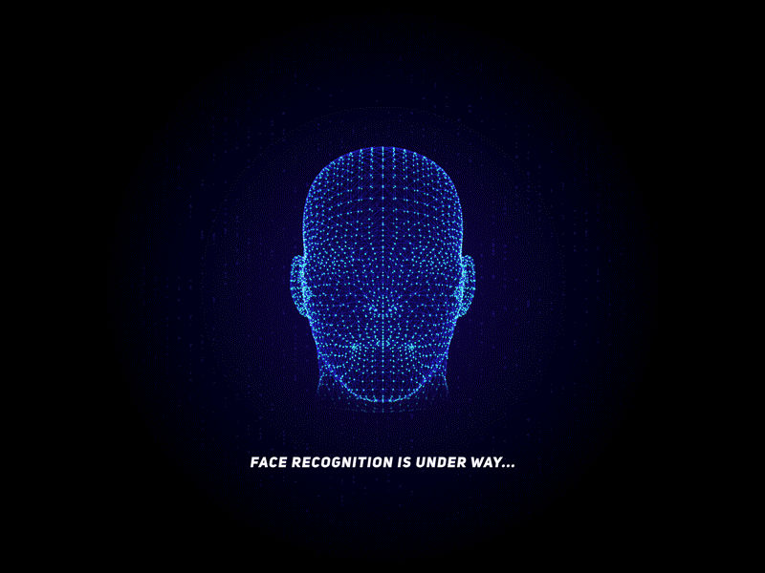
INTRODUCTION
Computer-based face recognition, along with other biometric approaches, is a mature and trustworthy technology that is widely employed in many access control settings.
Face identification is a practical requirement in the real world, primarily for human identification and surveillance. Facial identification systems are employed throughout the world today by governments and private companies.
Face perception is tough, but Siamese Networks provide a viable solution for similar problem articulations. Siamese networks are extremely powerful networks that have resulted in considerable improvements in applications such as face recognition, signature verification, and prescription drug identification.

Slide 4
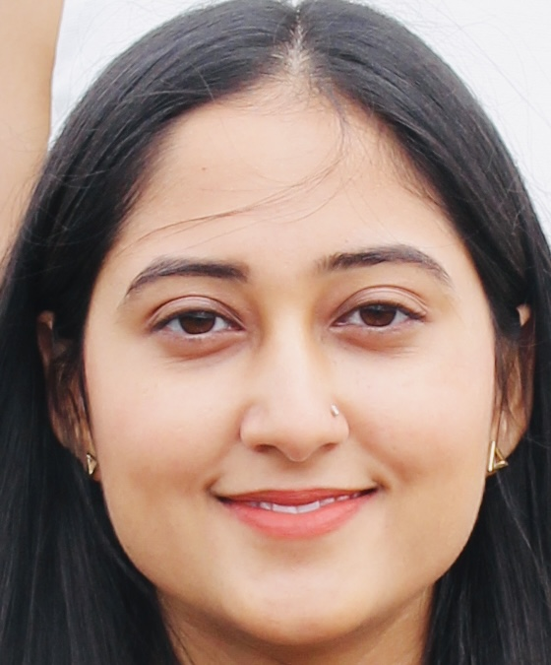

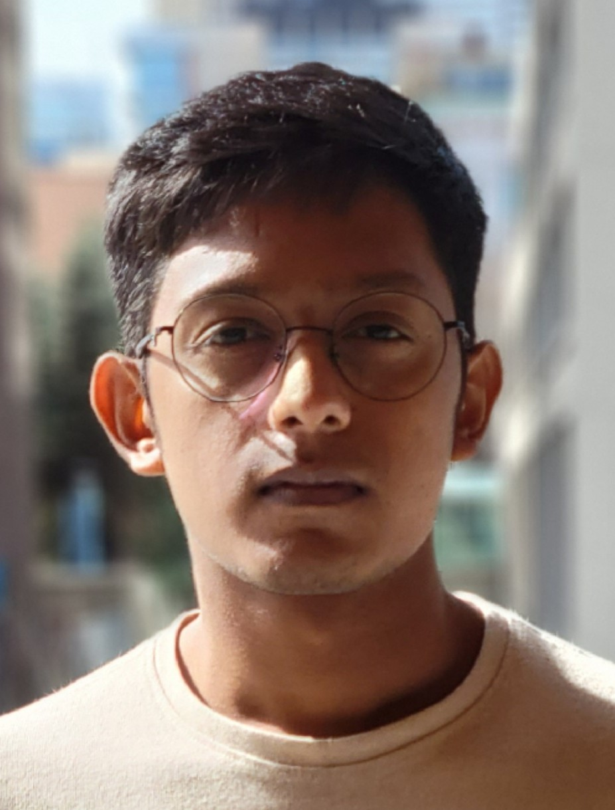
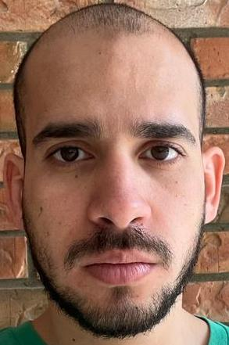

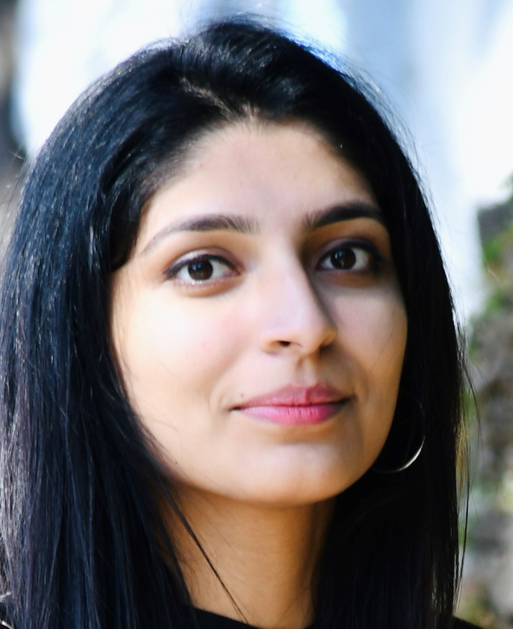
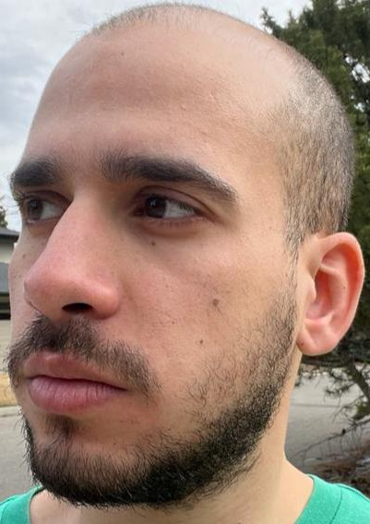
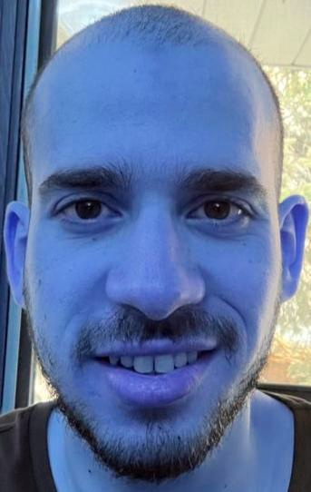
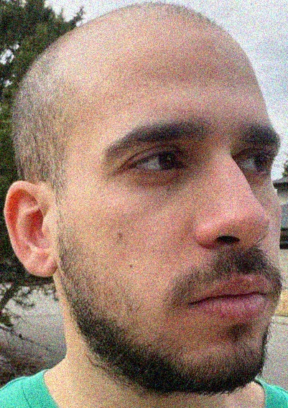
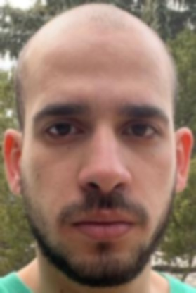
CREATING DATA
Data Augmentation
Rotated the image anti-clock wise
Blurring the image
Adding Noise

Slide 5
Data pre-processing
Resized images as an array of (128,128,3)
Label is given after comparing every images to each other
Preparing dataset: 72
Comparison result: 5184
Pairs belongs to same class are given label 1
Those are different were given 0
Two arrangements of images: X1 & X2
Shape (5184, 128, 128, 3) with 5184 labels

Slide 6
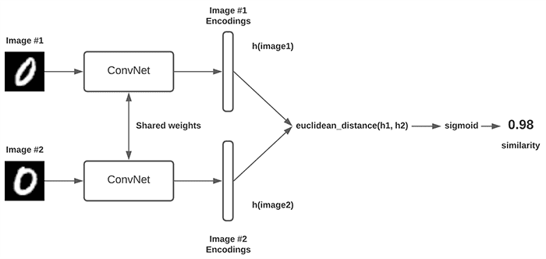
Siamese network
Neural networks are practically perfect at almost every activity in the present Deep learning era, but they rely on additional data to perform properly.
However, we can't always rely on more data for specific problems like face recognition and signature verification; to handle these challenges, we have a new form of neural network architecture called Siamese Networks.
To obtain better predictions, it only employs a small number of images.
Siamese networks have been more popular in recent years due to their capacity to learn from relatively little data.

Slide 7
Training the model
The test data set consists of 36 images from different classes, which are then passed to the model that has been trained to calculate the similarity score.
The image is classified into the class for which the highest similarity score is observed.
The results are achieved with a batch size of 7 and 100 epochs.
We split the data in the ratio of training and validation data is 4000:1184 (78% : 22%).

Slide 8
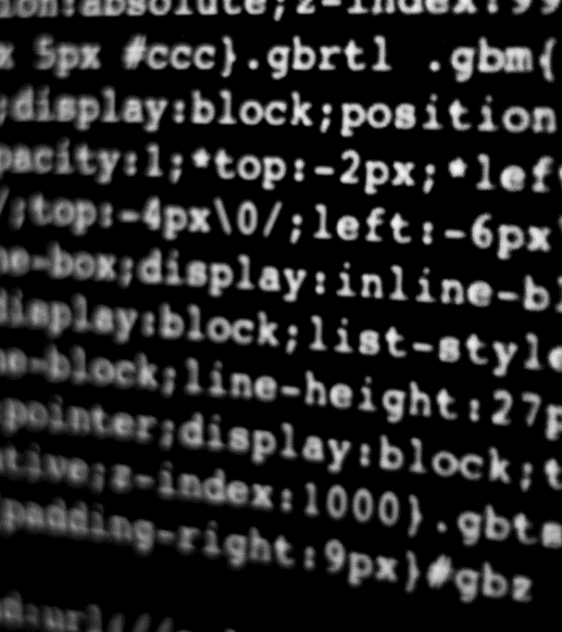
Results
Let’s Dive In

Slide 9
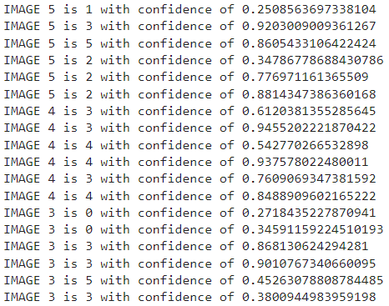
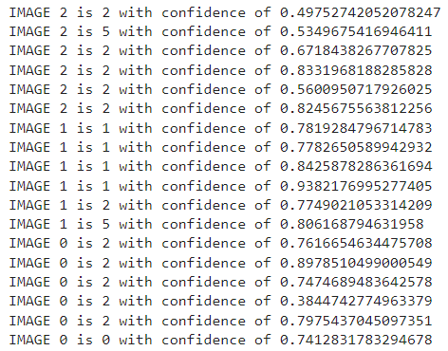
Actual vs predicted images along with confidence score
Label | Member
0 | Ahmad
1 | Ammaar
2 | Jasneet
3 | Lakshmi
4 | Parth
5 | Ramneek

Slide 10
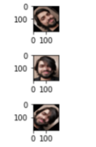
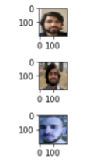
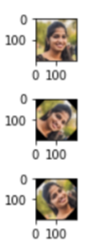
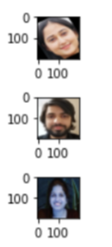
Actual vs predicted images
Custom Images
Predicted Images
Custom Images
Predicted Images

Slide 11
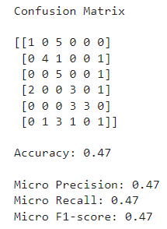
Confusion matrix
Class_Label | 0 | 1 | 2 | 3 | 4 | 5
0 | 1 | 0 | 5 | 0 | 0 | 0
1 | 0 | 4 | 1 | 0 | 0 | 1
2 | 0 | 0 | 5 | 0 | 0 | 1
3 | 2 | 0 | 0 | 3 | 0 | 1
4 | 0 | 0 | 0 | 3 | 3 | 0
5 | 0 | 1 | 3 | 1 | 0 | 1

Slide 12
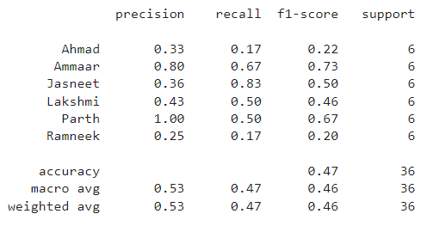
Classification report

Slide 13

challenges
Originally started with using a TALC cluster but ran into issues with installing certain required modules.
Google Colab has a limit on the number of resources we can use i.e., GPU runtime, thus it becomes difficult to train a model for a different set of hyperparameters for a longer duration.
We initially started with the data set of 8 images per person, however, we could not train our model with such a huge number of images due to the limitation of GPU runtime resources.

Slide 14
conclusion
Best result: 47% accuracy
Desire to approach the issue again and see if we can get better results

Slide 15
THANK YOU
Questions?
Group members
Ahmad elkholy – ucid#30120003
Jasneet kaur chahal – ucid#30119845
Lakshmi teja Makineni – ucid#30126350
Muhammad Ammaar Raihan – ucid#30139255
Parth satishkumar shah – ucid#30136276
Ramneek kaur – ucid#30138283

